Slide 1
Qwinix Soft Skills Training
Qwinix Training Cell

Slide 2
Day-1
Thinking in English

Slide 3
How to THINK in English
Thinking in English is the biggest tip for increasing your fluency because it makes you more confident and helps you speak more easily without hesitation.
Thinking in individual words
Thinking in complete sentences
Functional English
Narrative English

Slide 4
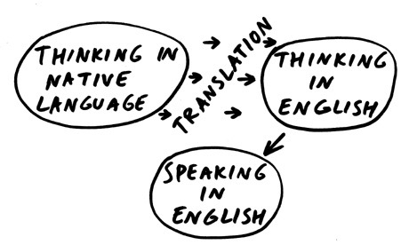

THINKING
Why Think in English?

Slide 5
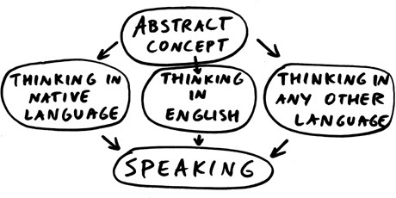

Slide 6
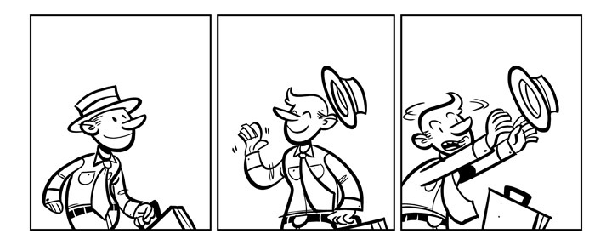
What is happening?

Slide 7
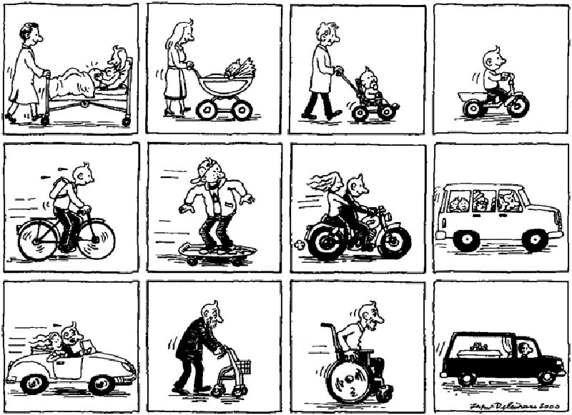
What is happening?

Slide 8
Activity

Slide 9
Day-2
Listening Skills

Slide 10
“I Remind myself every morning:
Nothing I say this day will teach me anything. So if I’m going to learn, I must do it by listening.”
–Larry King

Slide 11
HEARING V/S LISTENING
Hearing is simply the act of perceiving sound by the ear. If you are not hearing-impaired, hearing simply happens.
Listening, however, is something you consciously choose to do. Listening requires concentration so that your brain processes meaning from words and sentences.

Slide 12
Listening Skills
Patience
Tone
Eye Contact
Concentration
Stop Talking
Probe

Slide 13
Activity

Slide 14

Listen and Listen

Slide 15
Questions
Day | Time | Event | Venue | Ticket price
Monday and Tuesday | 7.30 p.m. | The Magic Flute’ (opera by Mozart) | 17 ............... | from £8.00
Wednesday | 8.00 p.m. | 18 ‘...............’ (Canadian film) | Cinema 2 | 19 ...............
Saturday and Sunday | 11 a.m. to 10 p.m. | 20 ‘...............’ (art exhibition) | Gallery 1 | free

Slide 16
Speaking
Grammar
Tone
Body Language
Choose your words
Clarity

Slide 17
Grammar
Noun and Pronoun
Verbs
Adjectives
Tenses
Direct / Indirect Speech

Slide 18
Nouns
Nouns : A noun is a part of speech that denotes a person, animal, place, thing, or idea.
Example :
Person – He is the person to see.
Person – John started to run.
Animal – The dog barked at the cat.
Place – Let’s go to the beach.
Place – Look over there.
Thing – Use words properly to be understood.
Thing – The lamp sits on a table next to the sofa.
Idea – Follow the rules.
Idea – The theory of relativity is an important concept.

Slide 19
Pronouns, Verbs and Adjectives
A pronoun (I, me, he, she, herself, you, it, that, they, each, few, many, who, whoever, whose, someone, everybody, etc.) is a word that takes the place of a noun.
eg: He is not coming.
Verb : A word used to describe an action, state, or occurrence, and forming the main part of the predicate of a sentence, such as hear, become, happen.
eg: I hear the train coming.
Adjective : A part of speech that describes a noun or pronoun. Adjectives are usually placed just before the words they qualify
eg: They live in a beautiful house.

Slide 20
Tenses

Slide 21
Direct/Indirect Speech

Slide 22
Tone and Body Language

Slide 23
Vocabulary and Clarity

